Slide 1
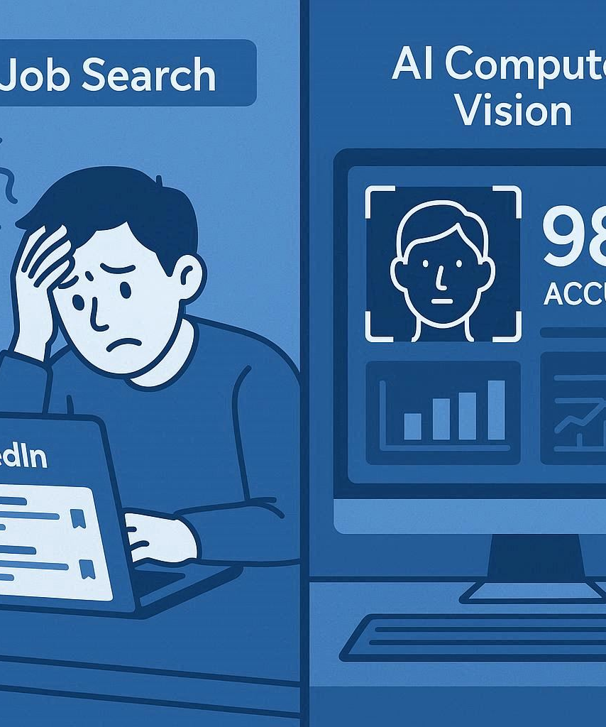
Job Board Vision Assistant
CHANDRA SEKHAR BOLLINENI
MSDS 692 – FALL 2025

Slide 2

About Me
I am Chandra Sekhar Bollineni, an international Master's student at Regis University. I have over 10 years of hands-on experience in IT from India, having worked as a Data Scientist, Data Engineer, and Analyst across both product-based and service-based companies. During my master's studies, I developed a deep interest in computer vision research, which led me to create this Job Board Vision Assistant.

Slide 3
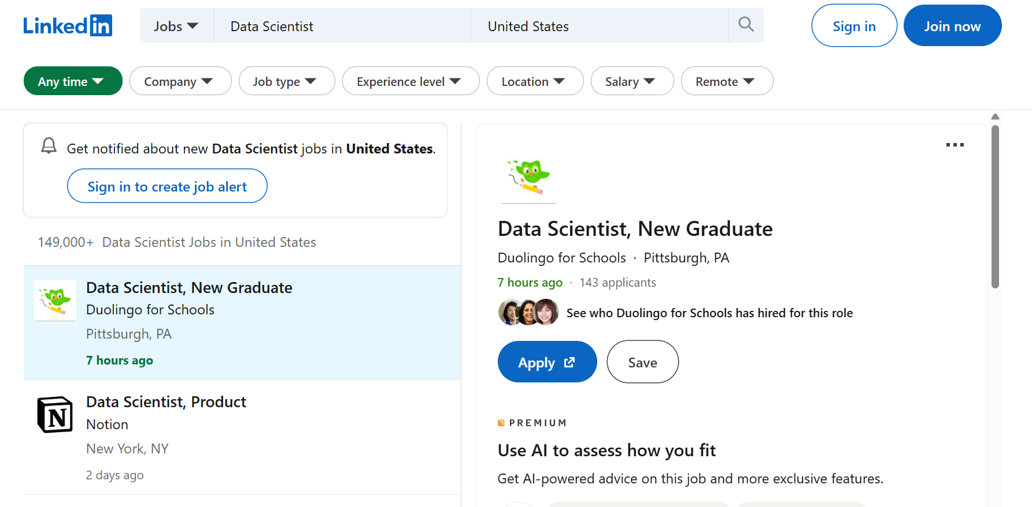
What We’re Building & Why
Job Board Vision Assistant
I have developed an intelligent platform that uses computer vision and machine learning to automatically analyze job postings, helping job seekers, recruiters, and HR professionals make better decisions and save time.
What is the research here?
How can we automatically extract and analyze job market intelligence from visual job postings?

Slide 4

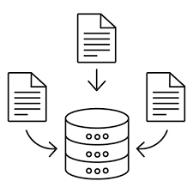


What We’ll Cover Today
Results Impact & Demo
Data Collection
Machine Learning Implementation
Computer Vision Solution

Slide 5




Data Collection Challenges
LinkedIn anti-bot protection
Visual data capture
Custom web automation (Selenium/Playwright)
Data Quality Issues
LinkedIn actively blocks automated access with a lot of anti-bot measures, making data collection extremely difficult.
Job postings are visual images with complex layouts, making it very difficult to automatically extract the structured data.
Webstites constantly change their structure, requiring highly customized automation to consistently scrape data without breaking.
Job postings often have missing information and inconsistent formatting, and varying data quality makes it difficult to build reliable machine learning models.
Overcoming these data collection challenges was essential for building the platform, which can extract job market intelligence from visual job postings.

Slide 6



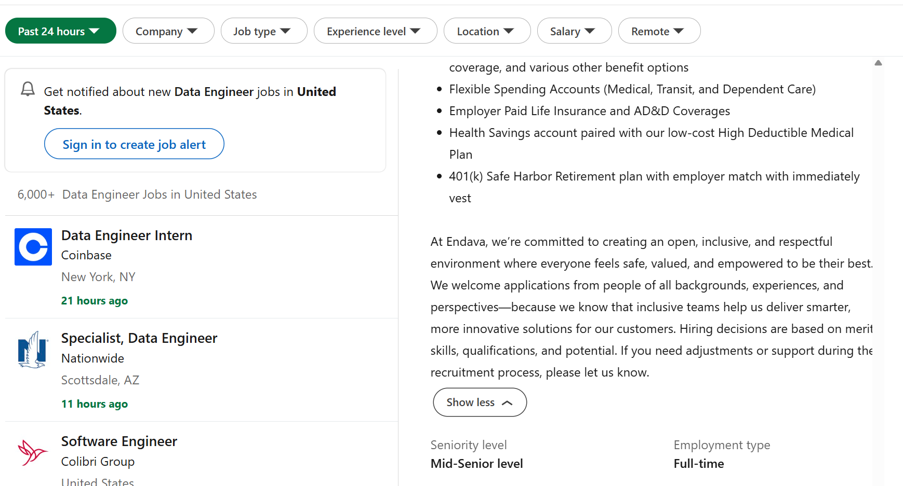
Data Collection: How I Solved It
Likendin Job Capture
Kaggle Dataset Collection
Used Playwright automation to capture LinkedIn job postings automatically.
Automated the collection of job market datasets from Kaggle, including salary data, job descriptions, and company information

Slide 7



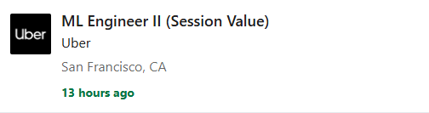

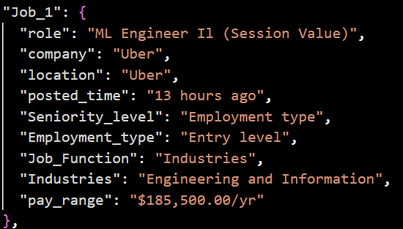
Computer Vision Approach
OCR Technology
Image Preprocessing
98% Accuracy in Text Extraction
I have utilized EasyOCR technology to accurately extract text content from LinkedIn job posting screenshots. This converts unstructured data into a machine-readable format for further analysis.
Implemented OpenCV preprocessing techniques including noise reduction, color adjustment, and text/background separation to enhance the image quality and improve OCR accuracy.
With the combination of EasyOCR and OpenCV preprocessing, my solution achieved an accuracy of 98% in extracting the relevant text content from job posting images, ensuring high-quality data for my machine learning models.

Slide 8

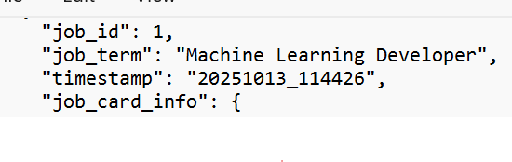
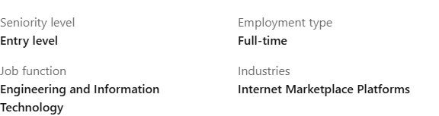
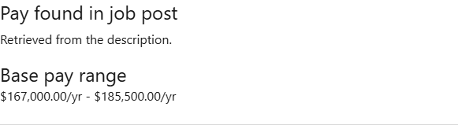
EasyOCR Text Extraction
OCR Text Extraction
Used EasyOCR extracts text from screenshots with 98% accuracy, then combines LinkedIn and Kaggle data with automated validation

Slide 9



CV Challenges & Solutions
Different Image Qualities
Complex Layout Detection
Data Quality Validation
Text Extraction Accuracy
Linkedin Job posting have different image resolutions, contrast, and clarity due to different browsers, screen sizes, and capture methods, making consistent text extraction challenging.
Job postings have complex layouts with multiple text elements, overlapping content, and varying font sizes, requiring different preprocessing to separate different text regions.
Implementing best validation to ensure extracted text is accurate and complete, filtering out noise, and ensuring only relevant job information is required.
Ensuring high accuracy in text extraction from visual job postings while handling different fonts, colors, and background patterns that can interfere with OCR perfrormance
By addressing these key challenges in computer vision, the job board platform consistently extracts job market data with high accuracy, enabling data-driven insights and decision-making.

Slide 10
Machine Learning Approach
Random Forest Classification
Hybrid ML + Rule-Based Approach
Feature Engineering
A powerful ensemble learning algorithm used to classify the job postings into different categories based on their textual content.
A combination of machine learning and rule-based systems to leverage the strengths of both approaches in extracting job market intelligence.
The process of creating and selecting relevant features from the job posting data to improve the performance of the machine learning models.
Leveraging Limited Training Data
Handling Missing Salary Information
Achieved 98.6% Accuracy
Techniques like data augmentation and transfer learning were used to overcome the challenge of limited labeled job posting data for training the machine learning models.
Rule-based algorithms and imputation methods were used to estimate salary ranges in the absence of explicit salary data in the job postings.
The combination of machine learning and rule-based approaches resulted in a highly accurate system for extracting job market intelligence from visual job postings.

Slide 11




Machine Learning Challenges & Solutions
Limited training data
Missing salary info
Rule-based fallbacks
Lack of large-scale, labeled datasets for job market intelligence made it challenging to train robust machine learning models. Overcame this by leveraging transfer learning and building custom data annotation pipelines.
Many job postings did not include explicit salary ranges, making it difficult to accurately predict compensation. Addressed this by combining rule-based extraction with ML-powered inference using related features like job title, location, and seniority.
Developed a hybrid approach that integrated rule-based logic to handle edge cases and complex data, complementing the machine learning models and improving the overall accuracy of the system.
98.6% accuracy
Despite the challenges, the final machine learning models achieved an impressive accuracy of 98.6% in extracting and classifying key job market intelligence from the job postings, exceeding the initial target.

Slide 12
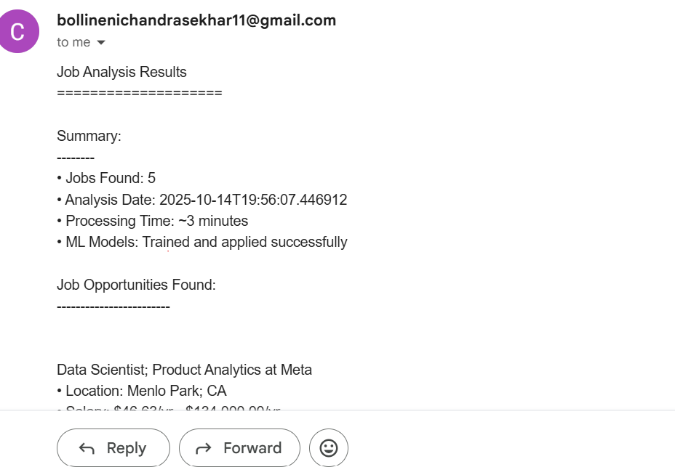
Email Automation Automated Intelligence Reports
Automated email system delivers personalized notifications with comprehensive job analysis, including categories, salary predictions, and company insights. Each report highlights key trends and top opportunities for informed decision-making, while providing direct links to original job postings for quick access and application.

Slide 13

DEMO

Slide 14
Commercial Future
HR Departments
Empower HR teams to streamline hiring processes and make data-driven decisions using real-time job market insights.
Recruiting Agencies
Enable recruiting firms to identify top talent more efficiently and better match candidates to open positions.
Job Boards
Integrate the Job Board Vision Assistant's automated job analysis capabilities to provide enhanced job search and recommendation features.
Scalability
Leverage cloud-based infrastructure and APIs to seamlessly scale the solution to handle growing volumes of job data and user demand.
API Integration
Offer a comprehensive API that allows partners and third-party applications to easily integrate the Job Board Vision Assistant's capabilities.

Slide 15

FOR ANY QUERIES,
PLEASE REACH OUT
EMAIL:
cbollineni@regis.edu
SPECIAL THANKS TO
ADVISOR - DR.MIKE BUSH
PROFESSOR - DR. CHRISTY PEARSON
THANK YOU
Notes:
Thank you for your time and attention. I'm happy to answer any questions you may have. Please feel free to reach out via email if you have further queries

